Slide 1
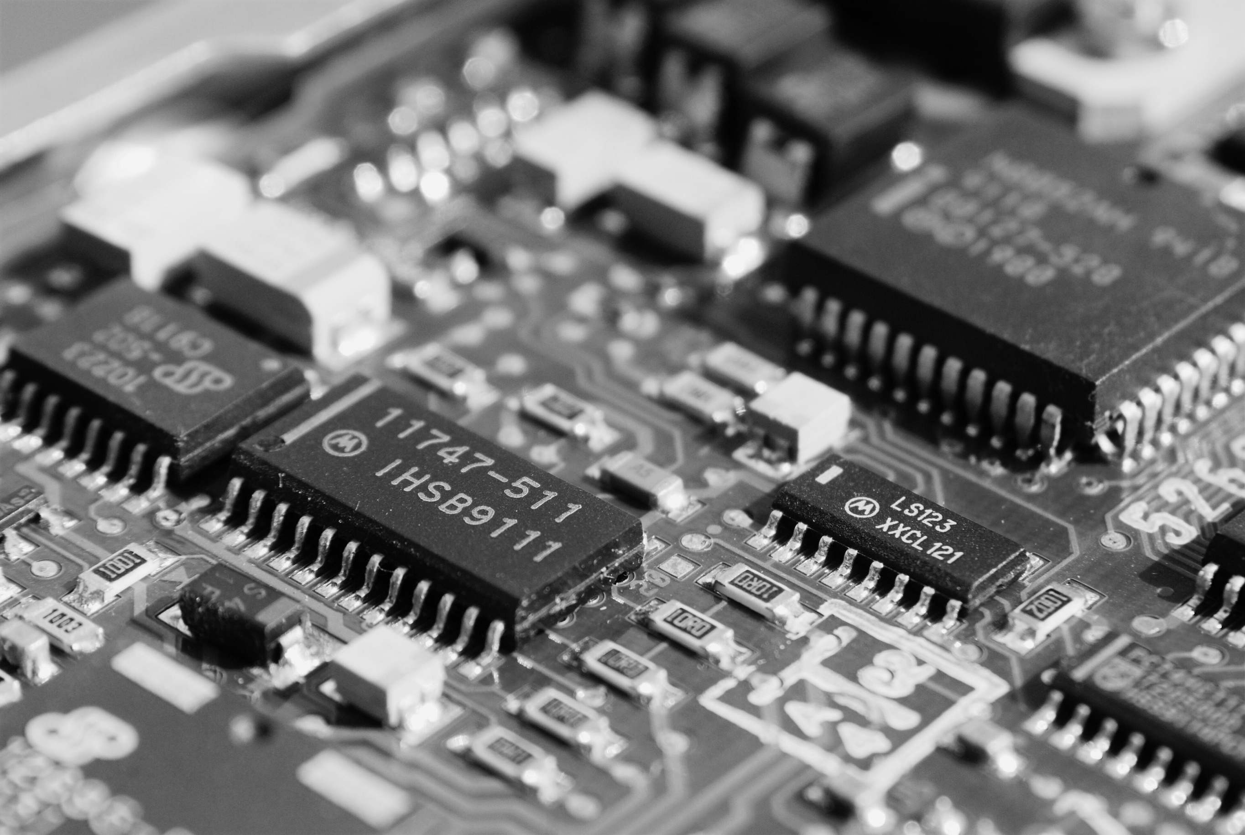

Department of Computer Science and Engineering
University of Dhaka
CSE-3116: Microcontroller Lab Project Report
Smart Tea Maker Machine
Submitted By
H.M. Mehedi Hasan (13)
Md. Abu Bakar Siddique (47)

Slide 2
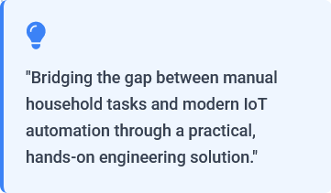
Project Motivation
Why a Smart
Tea Maker?
Task Automation
Automates the repetitive process of tea preparation, ensuring consistency in taste and saving valuable time for users in lab or home environments.
IoT & Remote Control
Demonstrates practical IoT implementation by enabling remote Start/Stop functionality and process monitoring via a Wi-Fi based browser interface.
Educational Value
Serves as a comprehensive learning platform for integrating multiple components: ESP32, sensors (IR), actuators (motors/pumps), and web technologies.

Slide 3




Project Innovations
Smart Design
Features
Wi-Fi & Web UI
Full system control via a hosted web interface. Users can Start, Stop, and override wait times (CONTINUE) from any browser.
Direct IR Trigger
IR sensor directly triggers the relay for immediate pump activation, reducing latency and ensuring precise water dispensing.
Coordinated Motion
Synchronized state machine manages Servo (dosing) and DC Motor (conveyor) timing to prevent spills or empty cups.
Safety & Modularity
Relay-based isolation for the pump and a modular shared-ground design allow for easy extension with future sensors.

Slide 4
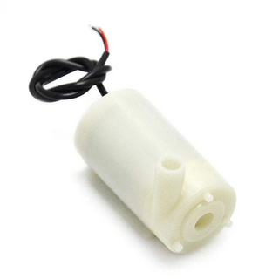
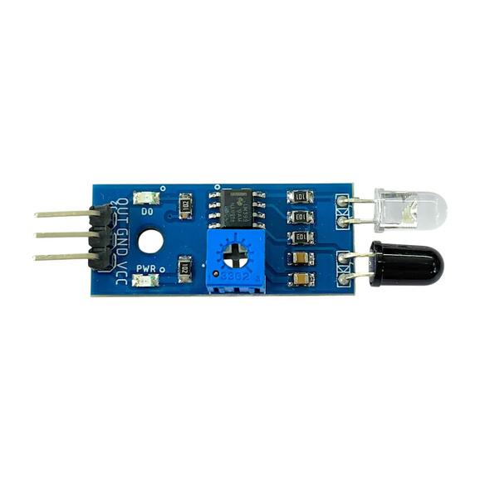
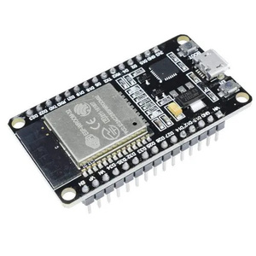
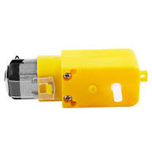
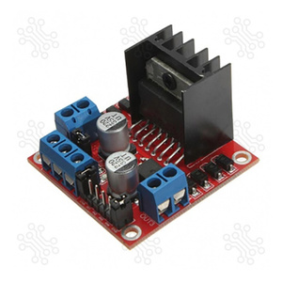
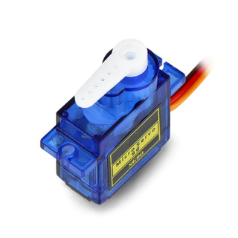
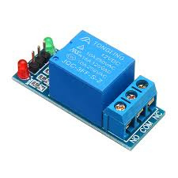
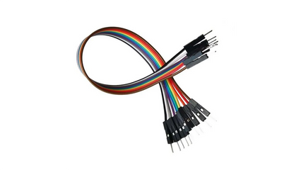
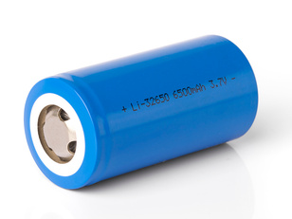
Components & Implementation
Hardware Configuration
IR Sensor Module
5V Pump
L298 Motor Driver
ESP32 Microcontroller
6V DC Motor (Conveyor)
Jumper Wire
3.7 V Lithium Battery
Servo Motor (Dispenser)
Relay Module

Slide 5
Components &
Implementation
Software Environment
  IDE Arduino IDE
  Embedded C/C++
  ESP32 Wi-Fi + WebServer
  HTML & JavaScript

Slide 6
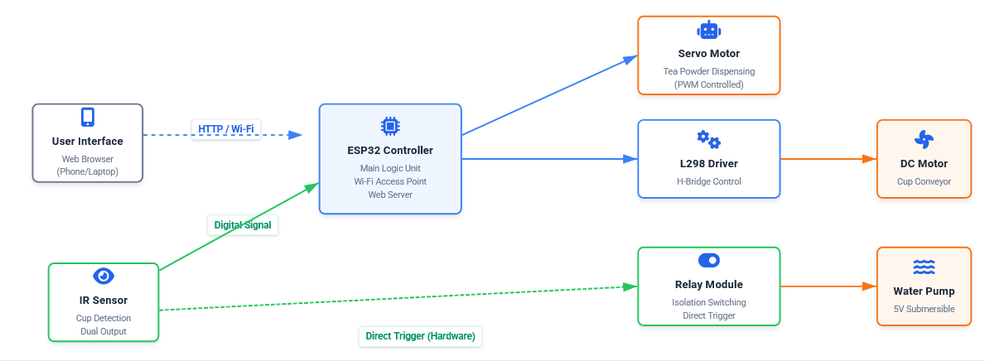
System Architecture

Slide 7
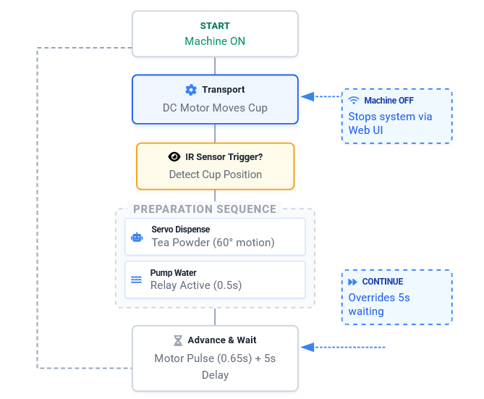
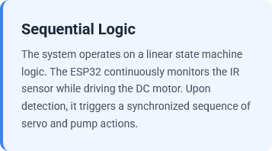
Working Principle
  Cup Detection stops conveyor immediately
  Servo dispenses powder (0° → 60° → 0°)
  Pump dispenses water for 0.5s

Slide 8
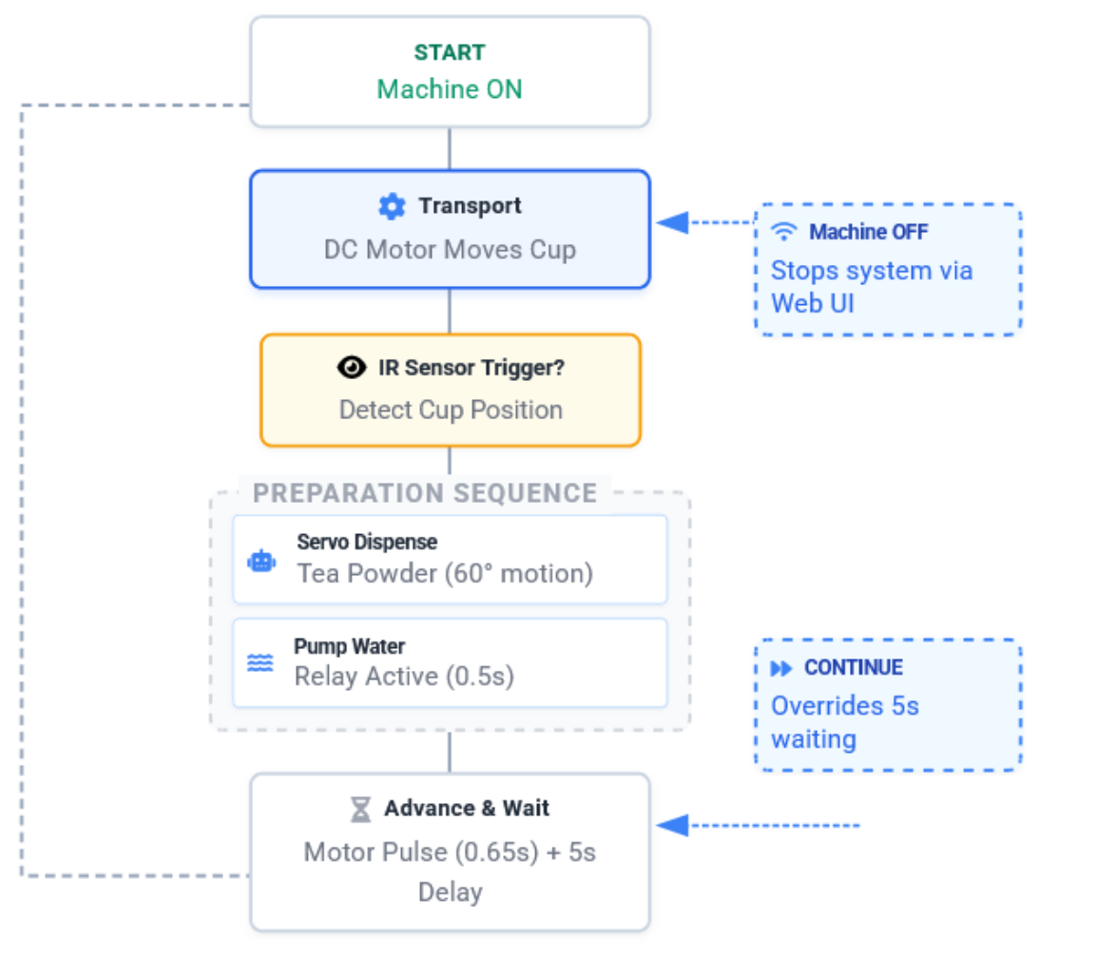
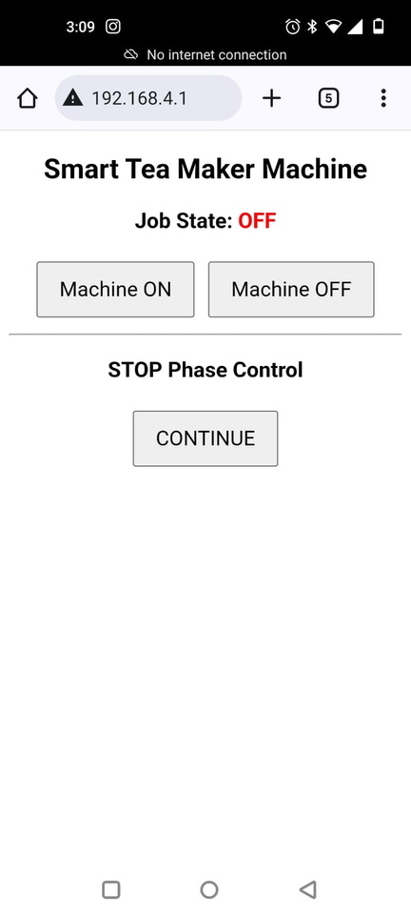
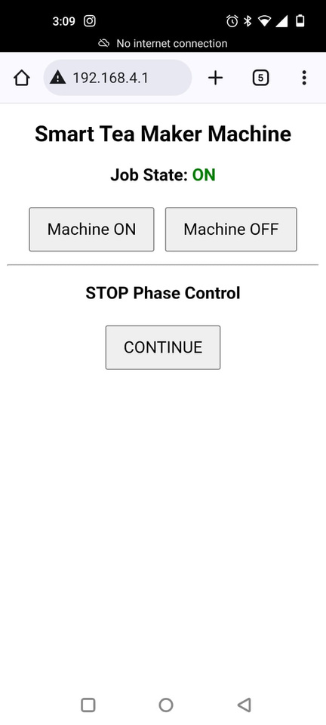
Smart Tea Maker
Workflow (step-by-step)

Slide 9
1
Step 1: Start
Machine ON
Next →

Slide 10
2
Step 2: Transport
DC motor moves the cup into position.
Next →

Slide 11
3
Step 3: Detect Cup
IR sensor checks cup position (trigger).
Next →

Slide 12
Step 4: Dispense Tea
4
Servo dispenses tea powder (≈60° motion).
Next →

Slide 13
Step 5: Pump Water
5
Relay activates pump (≈0.5s).
Next →

Slide 14
Step 6: Advance & Wait
Motor pulse (≈0.65s) then 5s delay.
Next →
6

Slide 15
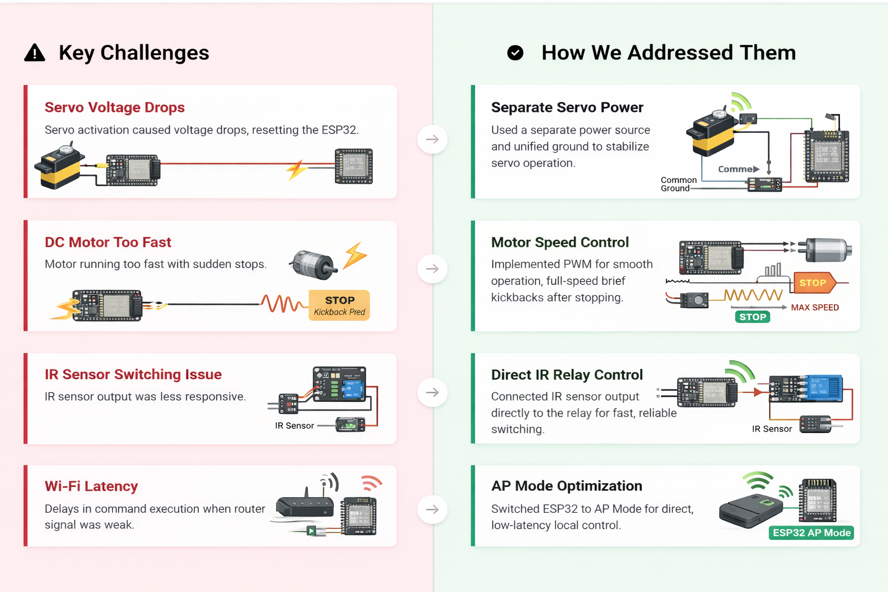
Challenges & Solutions

Slide 16
Conclusion
We have successfully designed and implemented a Smart Tea Maker Machine that automates the entire brewing process. By integrating ESP32, sensors, and actuators, we demonstrated a practical IoT solution that enhances efficiency and user convenience.

Slide 17
Thank You

